Slide 1

SPOTIFY
DATA ANALYSIS

Slide 2
DATASET OVERVIEW
Coverage: The dataset comprises 500 records of global music streaming data, including various artists, genres, and countries.
Artist & Track Profile: Captures essential details such as Artist Name, Song Title, Album, Genre, and Release Year.
Streaming Metrics: Includes key performance indicators like Total Streams (in millions), Monthly Listeners, Skip Rate (%), and Peak Chart Position.
Platform & Listener Insights: Provides information on Platform Type, Listener Demographics, and Listener Retention (%), offering engagement metrics.
Geographical Scope: Covers streams across different countries and regions, enabling country-wise performance analysis of tracks and artists.

Slide 3
TOOLS USED
Power BI

Slide 4
STEPS FOLLOWED
Step 1: Importing the data into Power bi.
Step 2: Understanding the data.
Step 3 :Performed Normalization and Data Modelling.
Created dimensional table - Dim_Country, Dim_Artist, Dim_Album, Dim_Genre, Dim_ Platform Type.
Created fact table.
Step 4 :Built a Power BI dashboard with targeted visuals to uncover trends and patterns in the streaming data

Slide 5
FINDINGS

Slide 6
1. Total number of artist – 16
2. Total monthly listeners (millions) – 25,520.61
3. Average streams (millions) – 2,581.15
4. Average skip rate - 20.37%

Slide 7
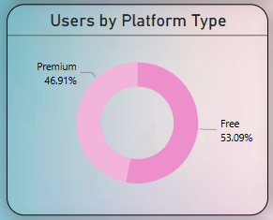
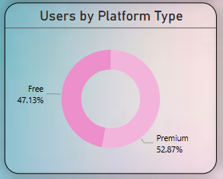
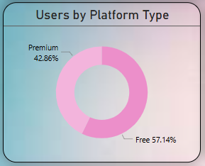
1. How have free and premium user numbers changed from 2021 to 2023?
While there was a rise in premium user percentage in 2021, a decline was observed in 2023.
2021
2022
2023

Slide 8
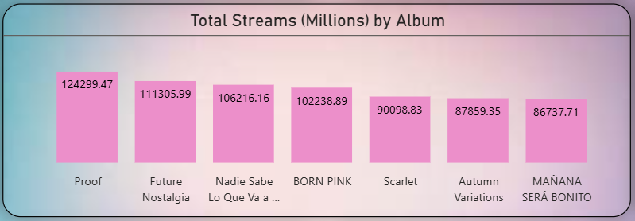
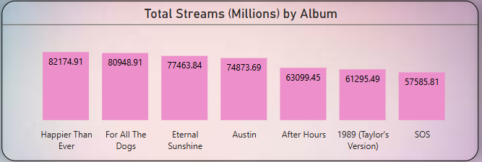
2. Which album has recorded the highest streaming numbers to date?
Top 7
Proof leads in total streams, with Future Nostalgia ranking second. SOS records the lowest number of streams among the listed albums.
Bottom 7

Slide 9
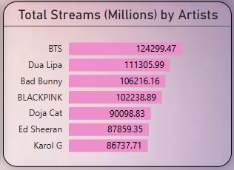
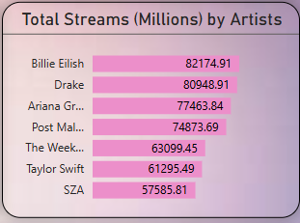
3. Which artists rank highest and lowest in terms of total recorded streams?
Top 7
Bottom 7
Among the artists, BTS achieved the highest total streams, closely followed by Dua Lipa, while SZA recorded the lowest.

Slide 10
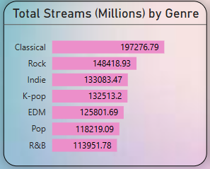
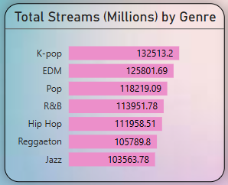
4. Among all genres, which one leads in total streams and which has the least?
Top 7
Bottom 7
Classical music has recorded the highest number of streams, followed by Rock, while Jazz has the lowest.

Slide 11
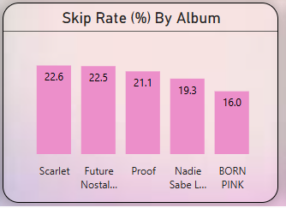
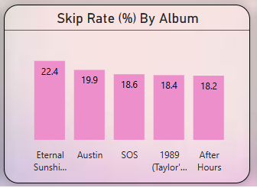
5. Which albums have the highest and lowest listener skip rates?
Top 7
Bottom 7
The highest skip rate was recorded for Scarlet, followed by Future Nostalgia, while After Hours had the lowest skip rate.

Slide 12
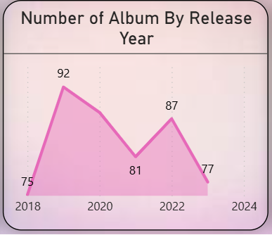
6. Which release year had the highest and lowest number of album releases?
From 2018 to 2019, album releases increased significantly. In 2020, there was a decline, followed by a rise again in 2022. However, by 2023, the number of releases had dropped compared to the previous peak in 2022.

Slide 13
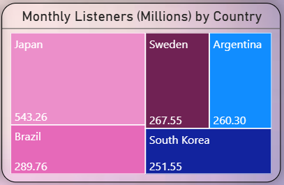
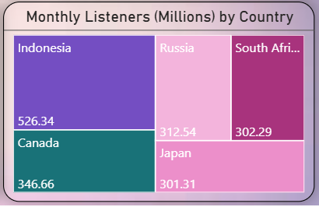
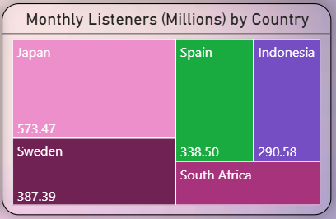
7. Which countries had the most monthly Spotify listeners from 2021 to 2023, and how did their rankings change over the years?
From 2021 to 2023, Japan consistently remained a top country for monthly listeners, peaking again in 2023. Indonesia showed strong growth in 2022 and stayed among the top in 2023. Countries like South Africa and Spain emerged in later years, while Brazil, Argentina, and South Korea, which were prominent in 2021, dropped out of the top rankings.
2021
2022
2023

Slide 14
RECOMMENDATIONS

Slide 15
Spotify should bring back the ideas that worked well in 2021 to get more premium users. Offering special content and deals can help attract and keep users. It's also important to ask users for feedback to understand why some stopped using premium in 2023.
Spotify should continue promoting these popular albums. Since SOS has the lowest streams, it's worth reviewing its marketing strategy or exploring ways to boost its visibility and engagement.
BTS leads in total streams, with Dua Lipa close behind, highlighting their strong popularity. Efforts should focus on supporting these top artists to maintain and grow their audience. For artists like SZA with lower streams, additional promotion or collaborations could help increase their reach and engagement.
Classical music is the most streamed genre, followed by Rock, showing strong listener interest. Spotify should continue to invest in these genres by adding more content and promotions. Since Jazz has the lowest streams, exploring new ways to engage listeners or refreshing the Jazz catalog could help boost its popularity.

Slide 16
5. Scarlet and Future Nostalgia have high skip rates, so they need improvements to keep listeners interested. After Hours keeps listeners engaged well with the lowest skip rate. Understanding why skips happen can help make albums better and reduce skips.
6. The fluctuating number of album releases suggests the need for better planning and support for artists during challenging times like 2020. To maintain steady growth, Spotify should encourage consistent releases through incentives and marketing support, especially after peak years. Monitoring trends can help time releases for maximum impact and audience engagement.
7. Japan remains a key market with strong listener numbers, so continued focus there is important. Growing markets like Indonesia, South Africa, and Spain offer new opportunities for expansion. Efforts should be made to re-engage listeners in countries like Brazil, Argentina, and South Korea where numbers have declined.

Slide 17
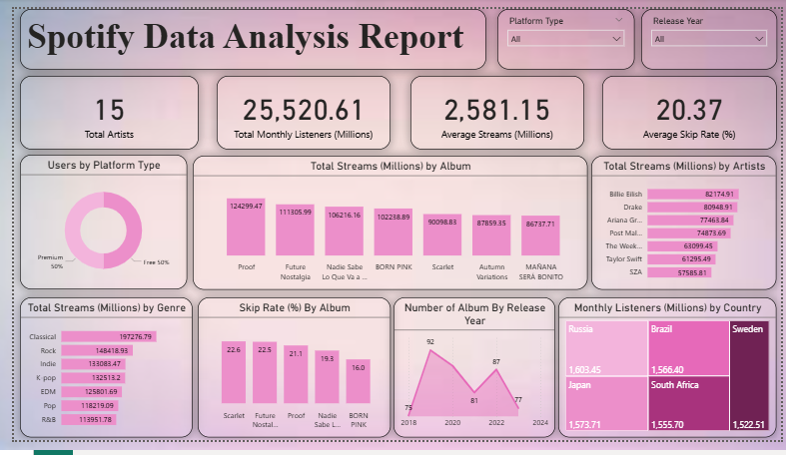

Slide 18
THANK YOU

